Slide 1
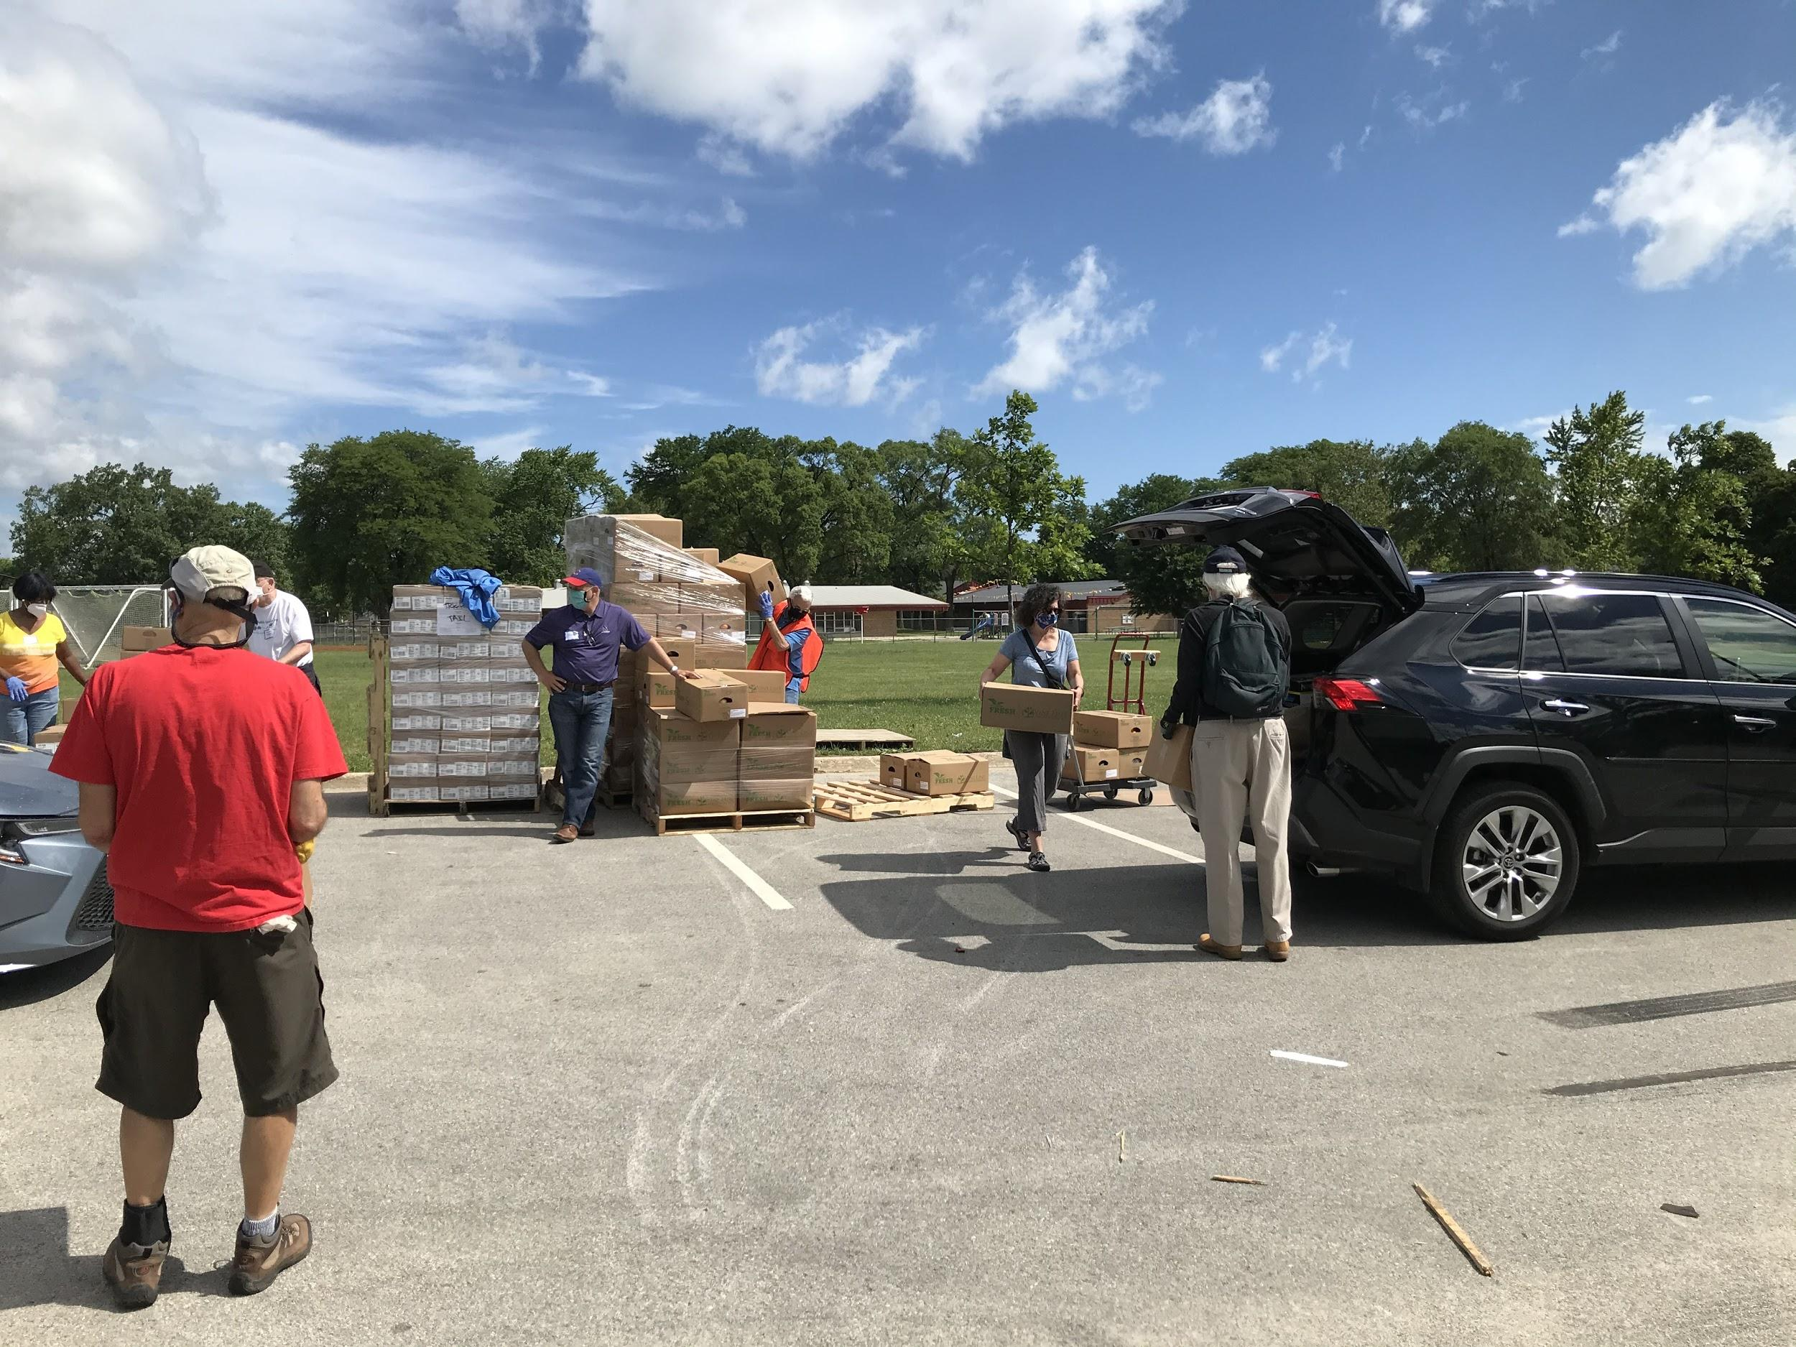
Everybody Eats
Evanston COVID-19 Food Insecurity Project
Summer 2020
Maura Shea
Mengxue Bi
Vanessa Corbett
Doris Cao
Adi Tyagi
Aria Wang

Slide 2
Everybody Eats ...
is the first step in a project aiming to build food security in Evanston. There is more to do.
is a collaboration between the City of Evanston Food Insecurity Task Force, Evanston Cradle to Career & Northwestern University’s McCormick School of Engineering.
This 10 week project sprint combined data analytics and design skills with the collective impact approach to develop insights and recommendations for how, in Evanston,
Everybody Eats.

Slide 3












Food Insecurity Task Force includes these organizations and more!

Slide 4
What Does the Data Show Us?
Food assistance data in Evanston is disconnected and inconsistent.
Each provider does his/her best to serve the people they know are in need
When viewed together, providers reveal a system of food assistance
Food insecure neighbors are unaware of the range of services available

Slide 5
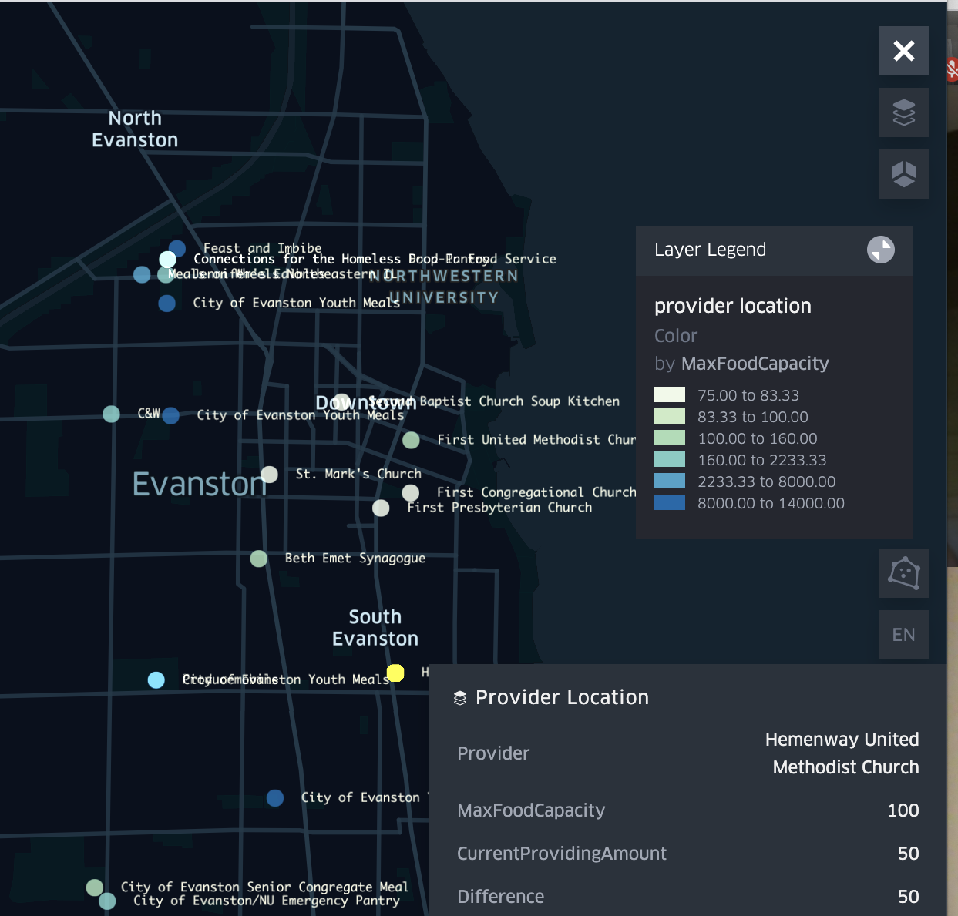
Make Food Assistance Information Visible
We developed a map of service providers showing location, capacity, food type, and more.
Neighbors in need and service providers can know:
What food services are available and where
What additional capacity a provider might have
Where there are gaps in service compared to level of need and what additional investments might be needed.
Map can be expanded to include additional functionality.

Slide 6
MAP DEMO
Notes:
Each provider shows up on the map as a dot, which is filled by a color representing the amount of meals currently being provided, and outlined by a color representing the maximum amount that could be provided potentially. (By comparing these two colors, we can identify the providers that are using smaller proportions of their meal capacities.)
Users’ home locations will show up in the map after they type their addresses into the search box on the top right. This will help users to have a general idea of distance to each provider.
Designed to show connections among providers
Designed to show name, location, enrollment number, FRL eligibility number and other detailed information about each school.
The color of each dot represents the free/reduced-price lunch eligibility rate.
The FRL eligibility rate in each school area can be used to approximate the food insecurity rate in the corresponding neighbourhood. The city may this to help decide the allocation of food resources.

Slide 7
Make Food Assistance Information Relevant
We developed a chatbot so that neighbors in need can receive recommendations based on their needs.
Information about SNAP application
Preference for grocery items or prepared meals
Identification of need and priority for delivery
Direct and recommend neighbor to closest relevant provider
Photo of chatbot

Slide 8
CHATBOT DEMO

Slide 9
Discussion about Map and Chatbot
Additional Features require more data
If the following data could be collected by each provider on a regular basis, organizations can better understand the need for delivery and people’s food preferences.
The distance that people travelled to distributions or the time it took them to go to a certain provider. (could be helpful to estimate the service radius of each provider)
Number of meals provided at each distribution. (With this information, we could easily do an animated mapping and look for patterns over time.)
Other suggestions?

Slide 10
Modeling & Hypothesis Testing

Slide 11
Objective & Methods
Objective: To identify the influential geographical/demographic factors that may drive food insecurity
Methodology:
Apply predictive models (multivariate linear regression model, random forest) on 2018 food insecurity population size for each geographic locations, with predictor variables selected/generated from the Policy Map (2014-2018) and the USDA Food Access Research Atlas (2015)
Look for the geographical/demographic factors that can explain the variations in the food insecurity population size
Run independent hypothesis tests (two-sample unpaired t-test) comparing the most food insecure zones and the least food insecure zones of Evanston to identify risk factors
Model Evaluation metrics: Adjusted r-squared scores, p-values

Slide 12
Variables in Our Data
Food insecurity indicator: 2018 food insecure population size from Feeding America
Geographical and demographic factors:
Policy Map (2014-2018)
Variables: Average size of household, average travel time to work in minutes, percent of households with any type of computer, percent of people with a Bachelor's degree, percent of all people who were men, percent of all people who were Hispanic or Latino, etc.
USDA Food Access Research Atlas (2015)
Variables: Low income population count beyond 1/2 mile from supermarket, Black or African American population count beyond 1/2 mile from supermarket, seniors population count beyond 1 mile from supermarket, total count of housing units without a vehicle in tract, total count of housing units receiving SNAP benefits, etc.

Slide 13
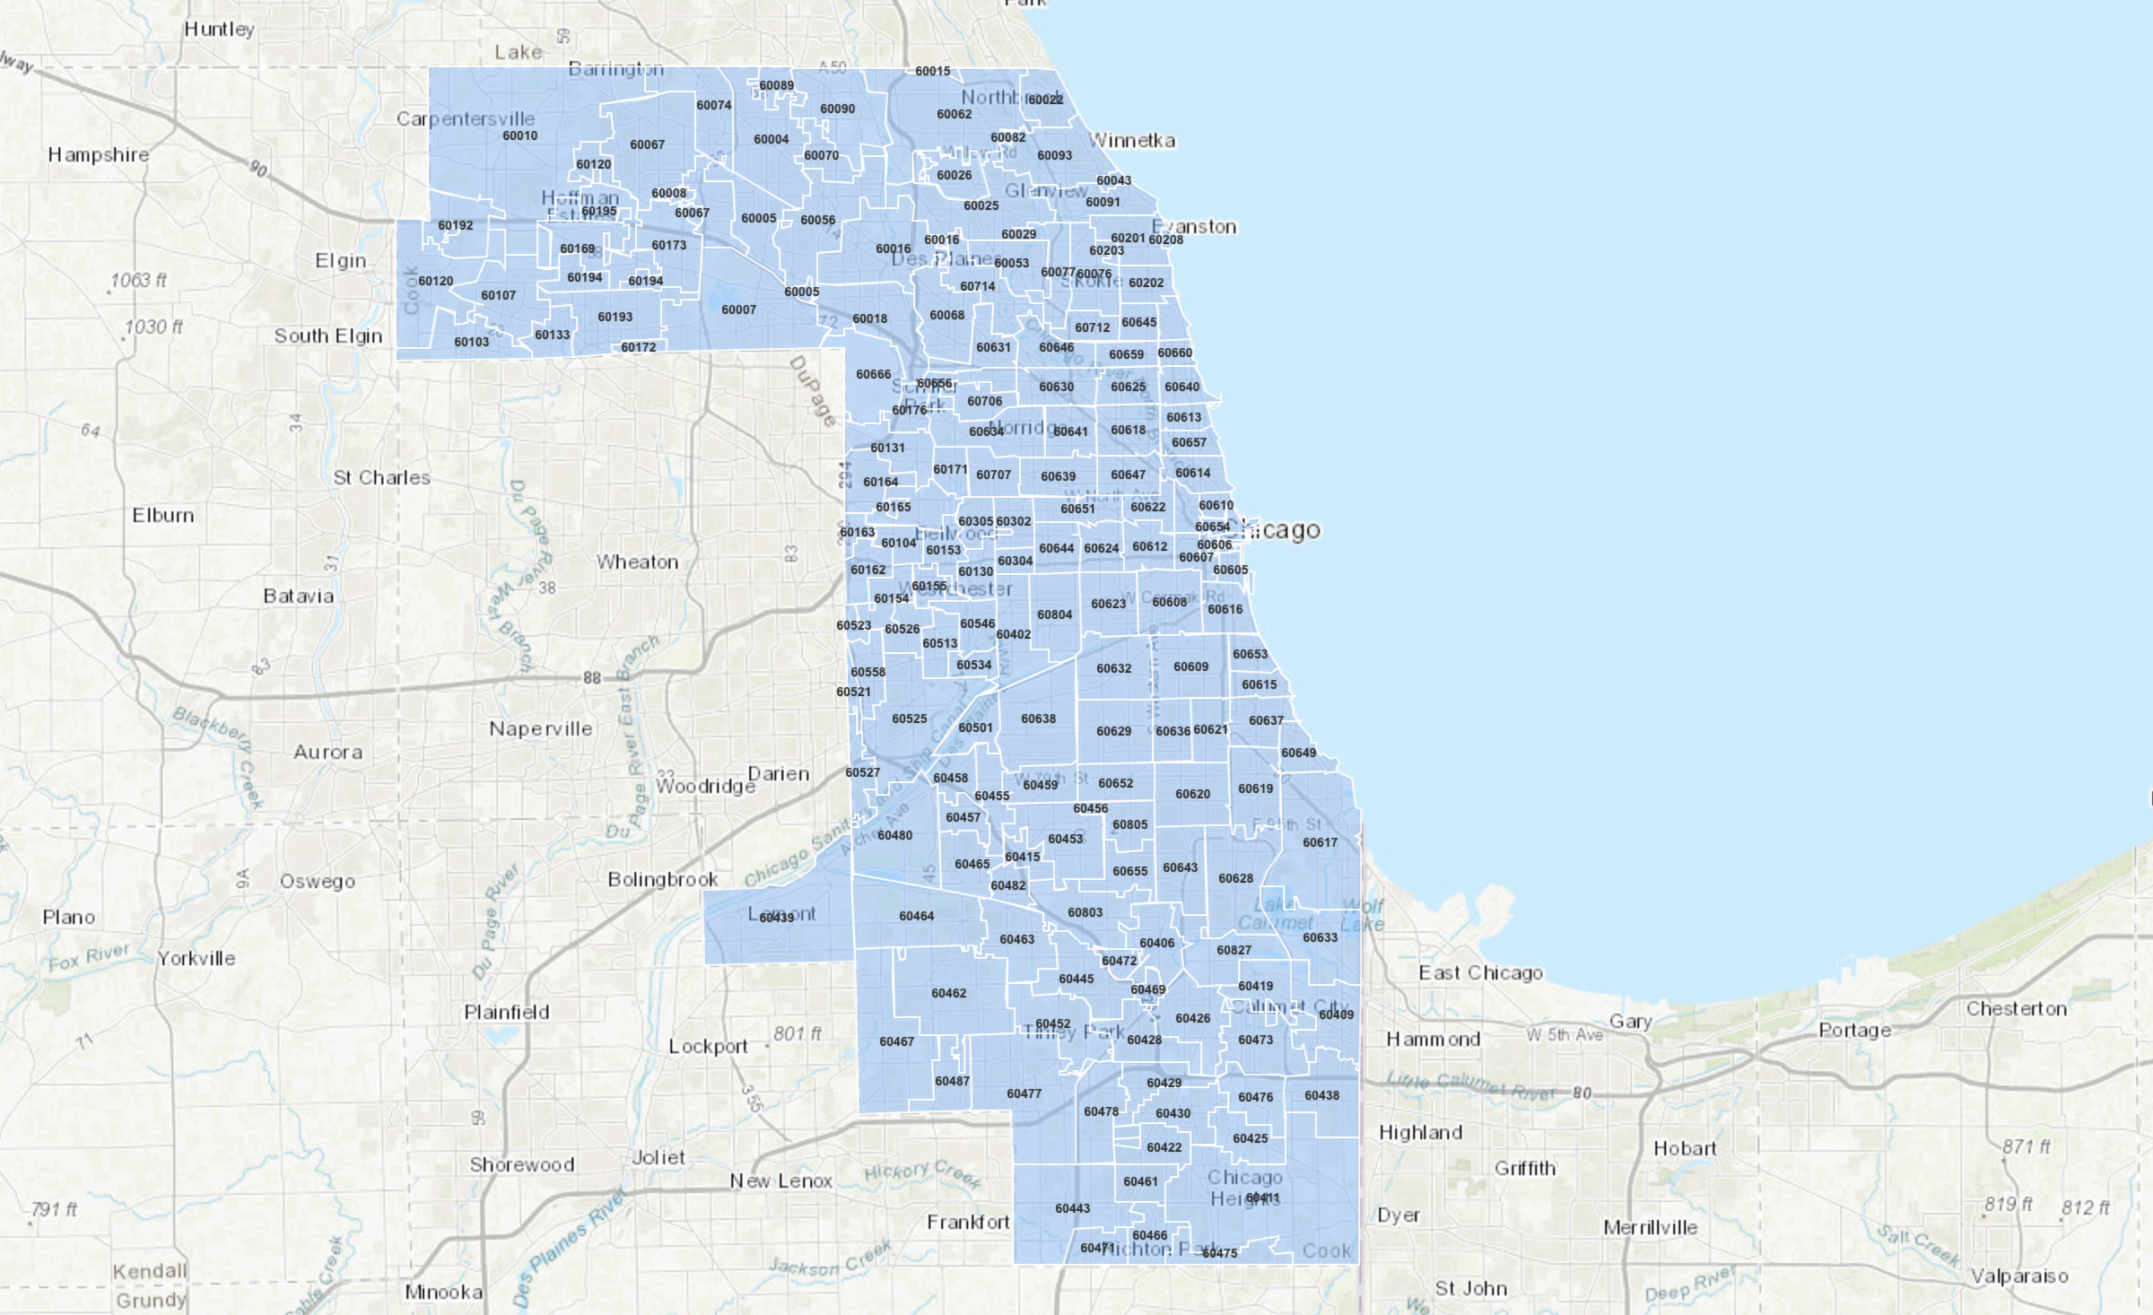
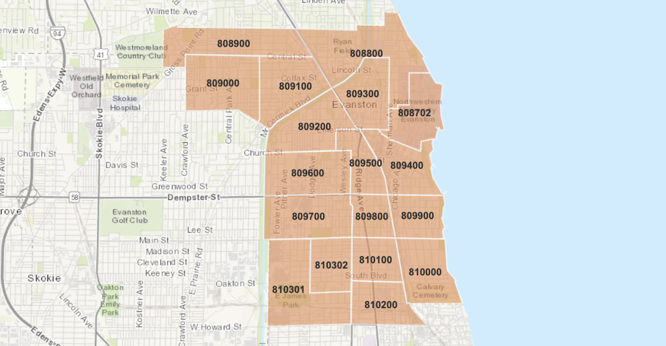
What factors are associated with the food insecure population size?
ZIP Code Level - Cook County
Key factors according to the random forest model:
Median household income ↓
% of families in poverty ↑
# of households receiving SNAP benefits ↑
Life expectancy (below 70)↑ (above 70)↓
# of households without a vehicle ↑
% of households with any type of computer ↓
Census Tract Level - Evanston Only
Key factors according to the multivariate linear regression model:
Median age ↓
Social Vulnerability Index ↑
Notes:
Show a map of census tracts & zip codes, list factors under levels,
List the factors that constitute the indexes (social vulnerability, thiel racial segregation,etc.)

Slide 14
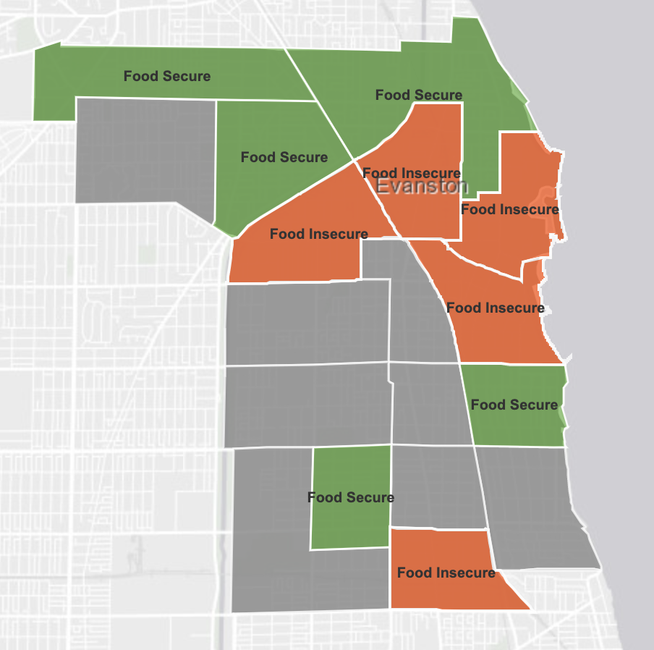
What are the distinctions between the most and least food insecure tracts in Evanston?
Compared to food secure tracts in Evanston, food insecure tracts are different in terms of:
A lower median household income
More socially vulnerable
Lower median home value
A larger % of non english speaking persons
Less racial segregated
Lower # of households with computer access
Compared to food secure tracts in Evanston, food insecure tracts are similar in terms of:
% of disabled (p-val: 0.761)
Average household size (p-val: 0.5318)
% of students in public school (p-val: 0.3729)
# of housing units (p-val: 0.1631)
# of jobs (p-val: 0.1327)
A lower median age
Lower median home loan amount
A larger % of nonwhite persons
A larger % of hispanic population
A smaller % with bachelor’s degree
Lower average travel time to work
% men (p-val: 0.7045)
Median leverage ratios (p-val: 0.4619)
% of families in poverty (p-val: 0.2086)
Life expectancy (p-val: 1468)
Note:
Hypothesis testing: a method for comparing two groups, and making conclusions in a statistically rigorous way.
p-value: a measure of confidence: a higher p-value indicates higher confidence in our null hypothesis.
Notes:
“There is something different about evanston census tracts vs. cook county census tracts.”
Order all variables based on p-values
Our similar variables are ordered in descending order of p value.
Visualize 5 most/least food insecure census tracts in Evanston (map)
Explain hypothesis testing on a high level

Slide 15
Next Steps & Potential Improvements
Next goal:
To understand the impact of COVID-19 on food insecurity and identify potential indicators of changes in the food insecure community in Evanston
Methodology:
Gather data that might tell the impact of COVID-19, and evaluate the reliability of using the collected variables to predict the food insecure population size in 2020. The data gathered should be updated frequently or can be easily collected on a regular basis, and the data should be on a geographical level as granular as census tracts or zip codes.
Current data sources:
Monthly data about the # of households/individuals receiving SNAP benefits by zip code in the Cook county
# of participants at monthly Producemobile distributions
Potential data sources:
Indicators of changes in the housing vacancies and homeownership, transportation, etc.
Any suggestions?

Slide 16
Thank you!

